Slide 1
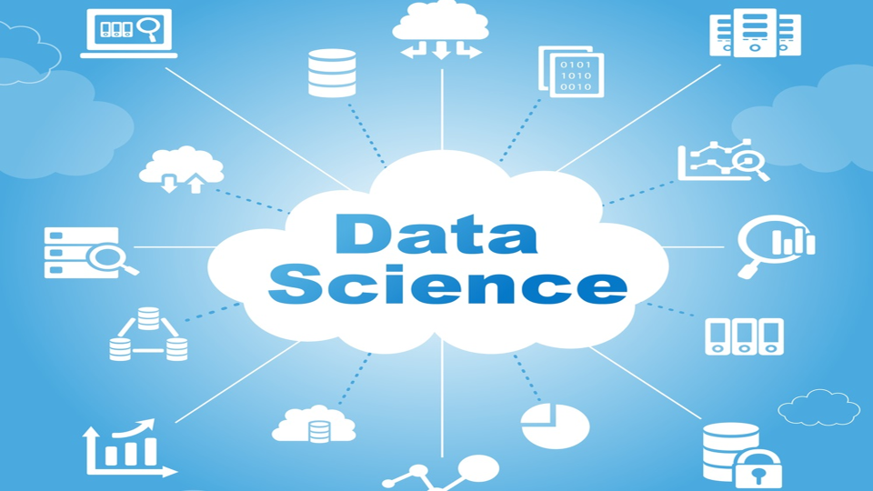
Data Science An Ocean of Opportunities

Slide 2

Welcome to Data Science World !!
Data World & Facts

Slide 3

Data World
DATA IS EVERYWHERE…
But a scarcity of talent with the skills to make sense of it and create a value.
Up to 20% of analytics jobs are going filled or are being filled with difficulty(Source: Randstad)
While analytics and big data industry is recording an annual growth of almost 40%, the sector is witnessing an acute shortage of professionals. Specialized training is important to grow analytics skills.

Slide 4

Facts
CONSIDER THESE FACTS
Analytics industry is growing at over 16% CAGR in India (Source:Nasscomm)
In India, average salary for analysts and data scientists is 10.4 Lakhs per Annum (Source:TOI)
Experts estimate a shortfall of approximately 200,000 data analysts in India by 2019 (Source: jigsaw Academy)
Harvard Business Review (HBR) has called Data Scientist as the "Sexiest Job of 21st Century"

Slide 5
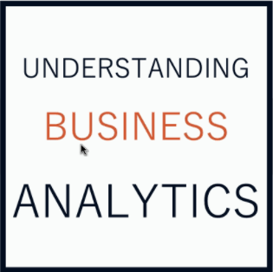
Understanding Business Analytics

Slide 6
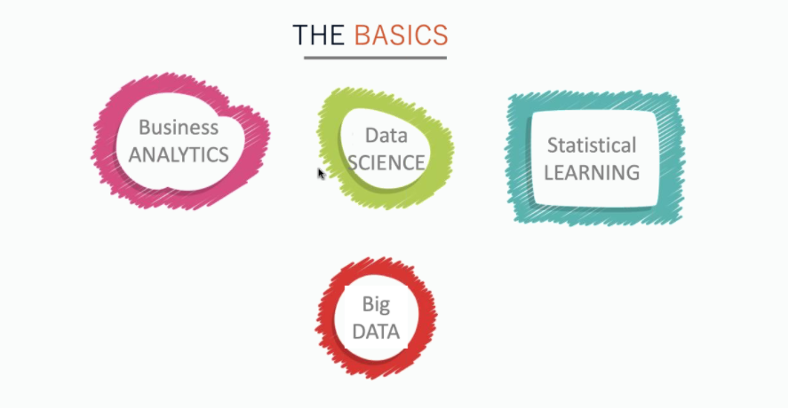
The Basics

Slide 7


Evolution of Decision Making
Everyone makes decisions. Individuals face personal decisions such as choosing a college or graduate program, making product purchases, selecting a mortgage instrument, and investing for retirement.
Managers in business organizations make numerous decisions every day.
What products to make and how to price them?
Where to locate facilities?
How many people to hire?
Where to allocate advertising budgets?
Whether or not make a Capital Investment?
How to Schedule Production?

Slide 8

Business Analytics
In our daily lives, decision we make is based on some information. Similarly, managers need good information and assistance to make such critical decisions that will impact not only their companies but also their careers.
What makes business decision complicated today is the overwhelming amount of available data and information?
So many data sources. So much information
How do you process so much information?
do you make use of so much information?
Business Analytics is the use of data, information technology, statistical analysis, quantitative methods, and mathematical or computer-based models to help managers gain improved insight about their business operations and make better, fact based decisions.

Slide 9
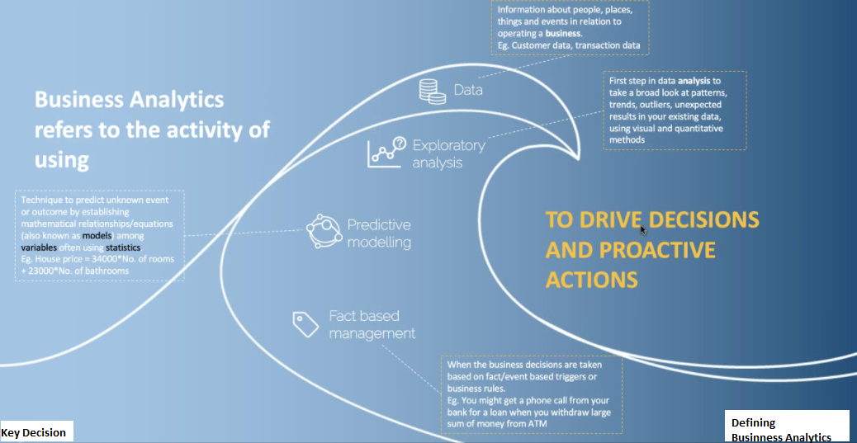
Defining Business Analytics

Slide 10
Types of Analytics

Slide 11
Types of Analytics

Slide 12
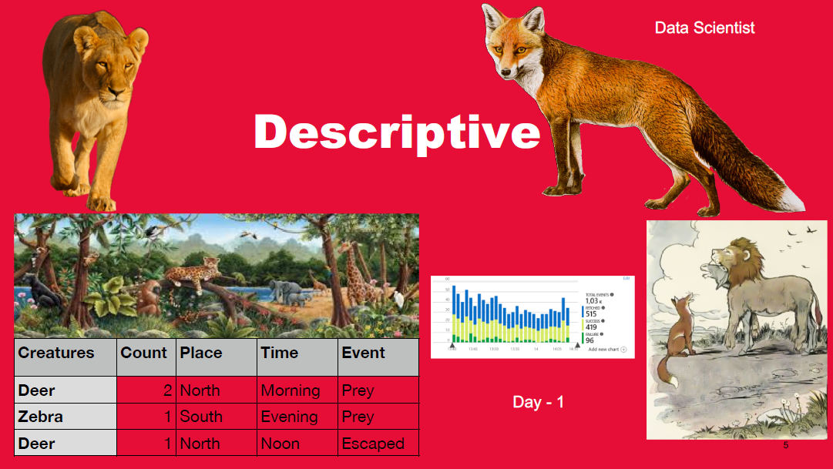
Descriptive Analytics

Slide 13
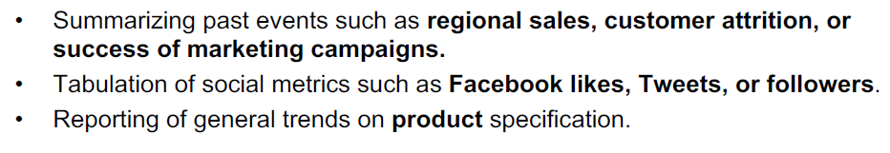
Example - Descriptive Analytics

Slide 14
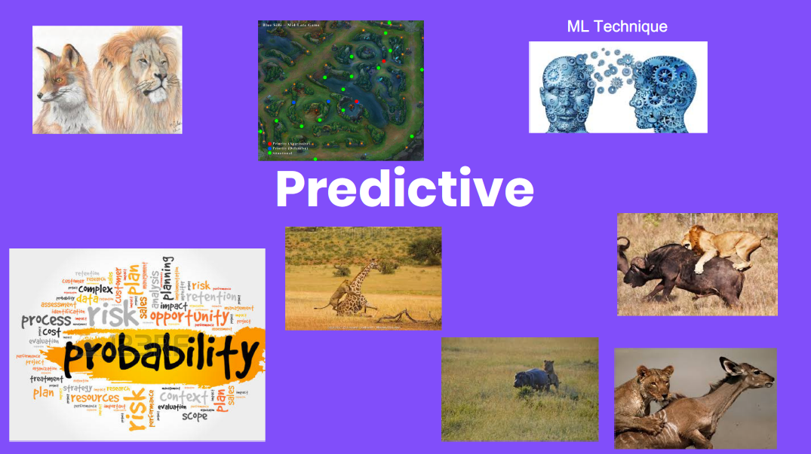
Predictive Analytics

Slide 15
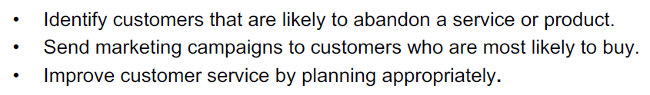
Example - Predictive Analytics

Slide 16
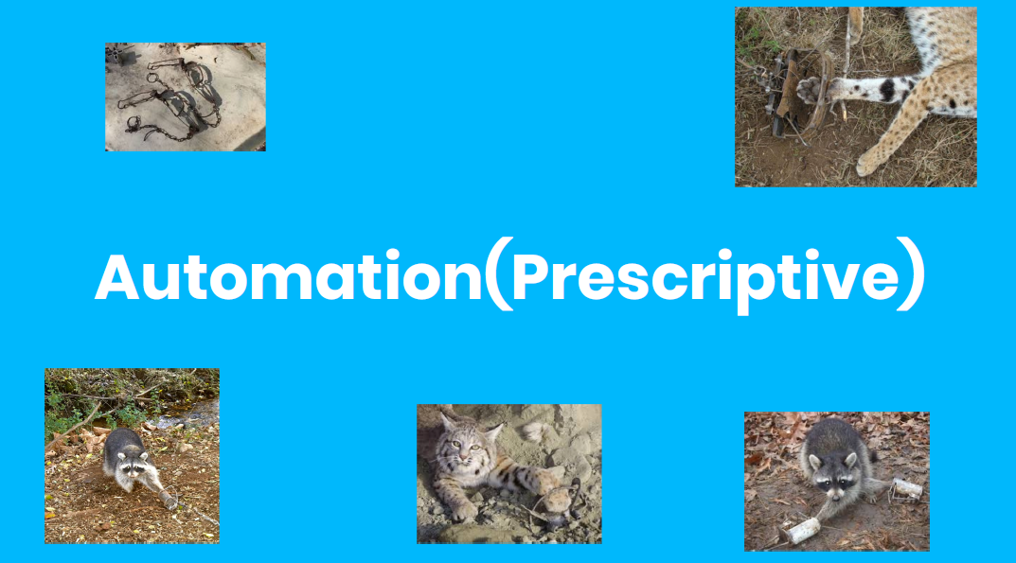
Prescriptive Analytics

Slide 17
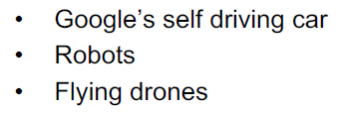
Example - Prescriptive Analytics

Slide 18
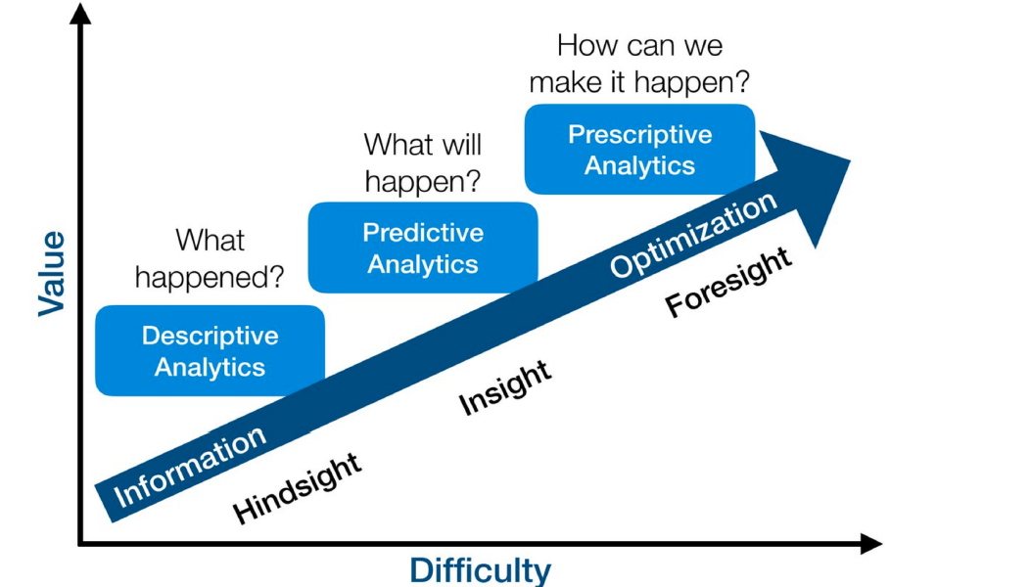
Analytics - Fact

Slide 19
Analytics - Fact

Slide 20
Understanding Data Science

Slide 21
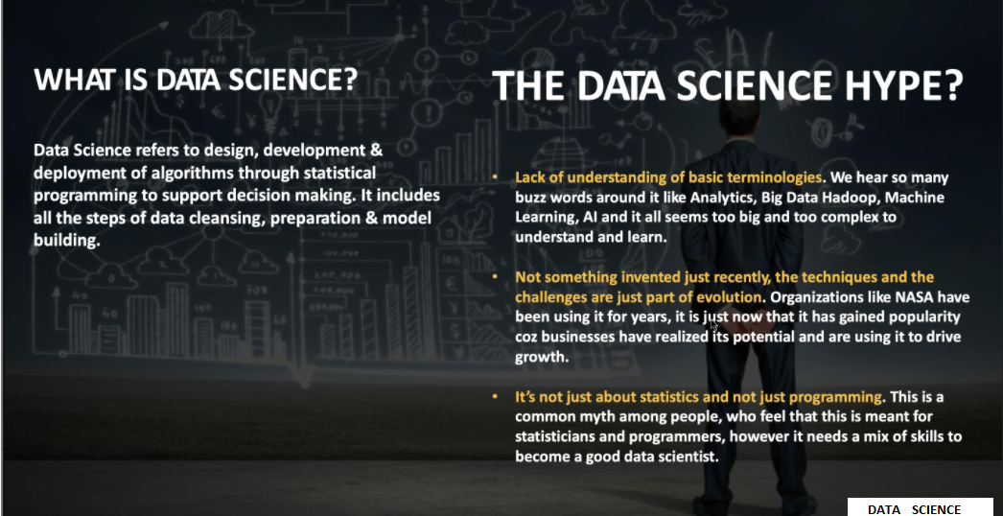
What is Data Science?

Slide 22
Understanding Big Data

Slide 23
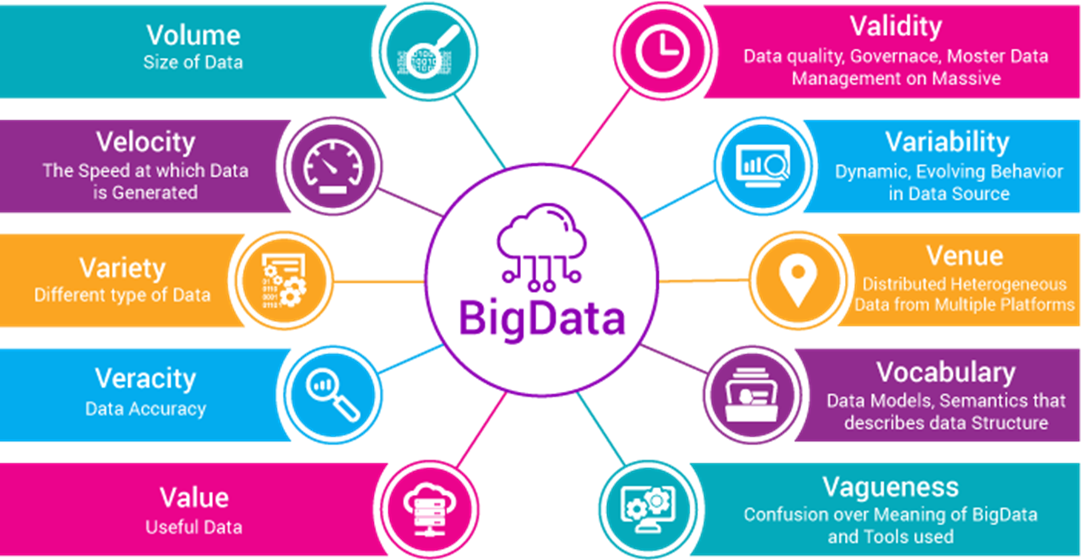
Big Data
Big data is a term for data sets that are so large or complex that traditional data processing application software is inadequate to deal with them.
Is it Just the size that defines my data as Big Data? No. Big Data can be described using 10 Vs

Slide 24
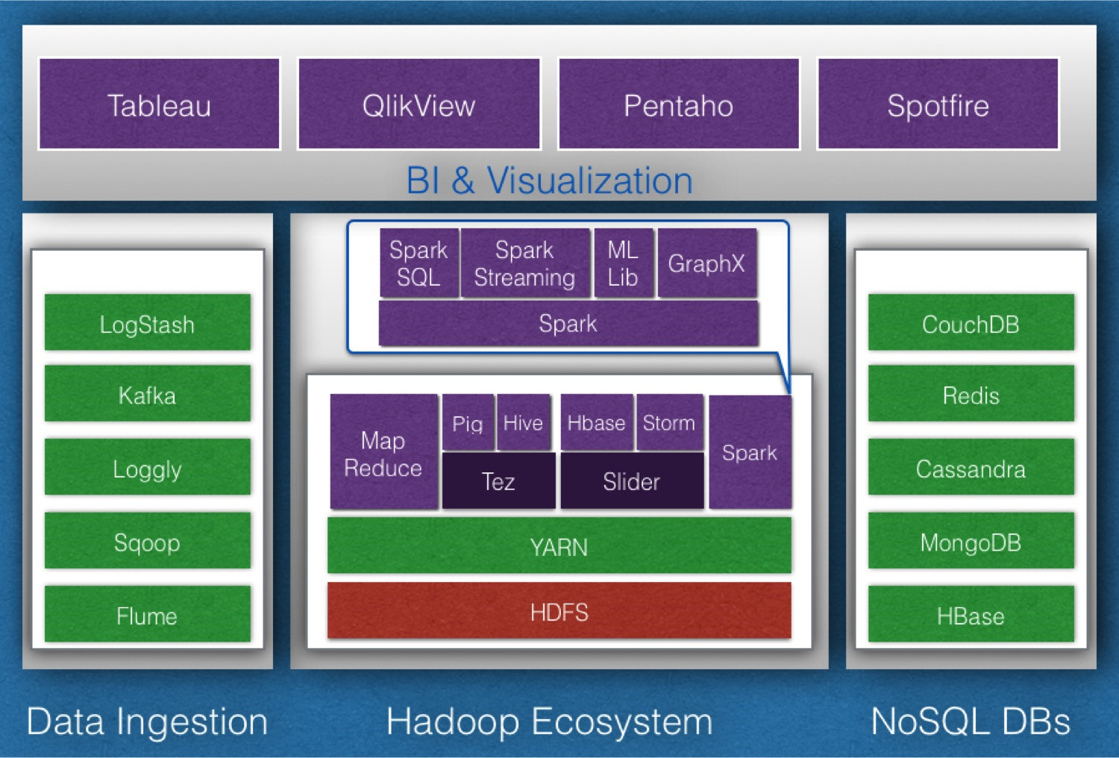
Technologies Associated with Big Data
Data Ingestion: Sqoop, Flume, Kafka, Loggly, LogStash
Data Processing: Spark, Storm
Data Analysis: Pig, Hive
Data Discovery: Lucene, Solr, Elastic Search
Machine Learning: Mahout, H2O, Spark Mlib
Coordination: Zookeeper
NoSQL DBs: HBase, MongoDB, Cassandra, Couch DB, Redis
Visualization: Tableau, Qlikview, Pentaho, Spot fire

Slide 25
Decision Making Examples

Slide 26

1.Decision Making Case Study – World Cup Football
The ability to extract knowledge from data presumably helped the Red Sox win the World Series in 2004 for the first time in 86 Years.
Wow. Great !! Decision Making helped lot.

Slide 27

2.Decision Making Case Study – Tesco Sales
Highly targeted & personalized communication leads to a leading retailer know more about a lady than her own family.
Data Science is not just about analysis, it is also about story telling and creating value for the business. This is an art which is learned through mentors, practical exposure and structured training programs.

Slide 28
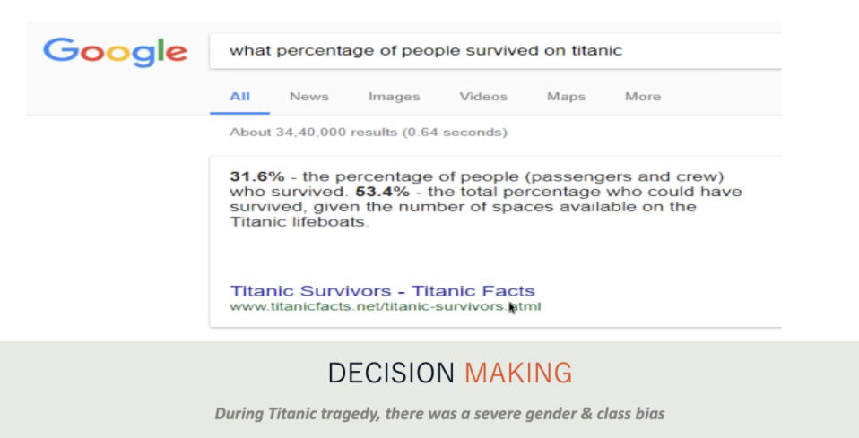
3.Decision Making Case Study - Titanic Tragedy

Slide 29
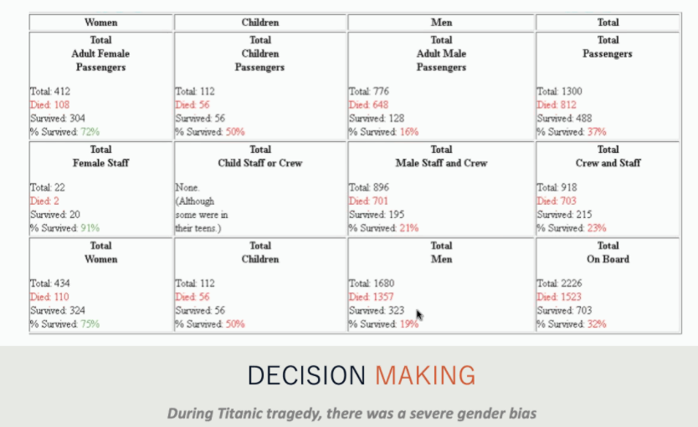
3.Decision Making Case Study - Titanic Tragedy..

Slide 30
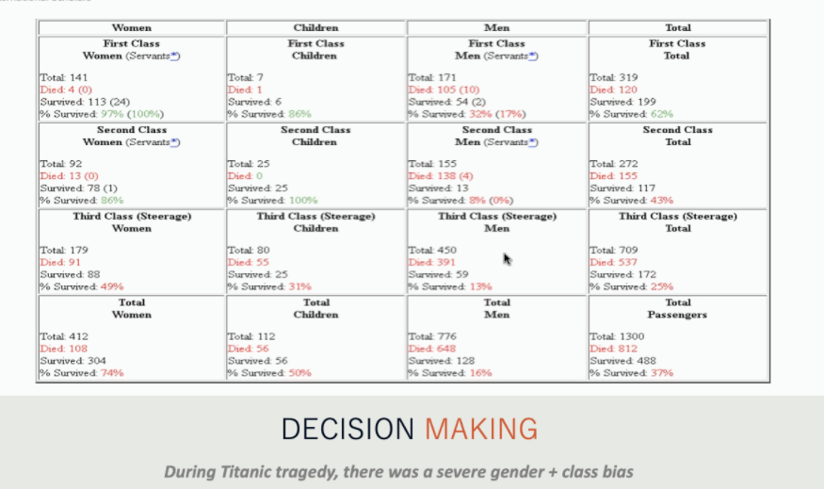
3.Decision Making Case Study - Titanic Tragedy..

Slide 31
Key Takeaways

Slide 32
Key Takeaways
We have learnt about the fundamentals of Data Science, Machine Learning and Big Data.
We have seen how powerful Data Science can be through some interesting case studies like Tesco, Red Sox and Titanic.
We have also looked at the skills that organizations look for when they evaluate you as a potential Data Scientist which is not limited to technical expertise but also skills in story telling and business understanding.
We have also tried to help you recognize the skills you need to pivot into this fascinating world of data science which includes basic skills like MS Excel, Data Visualization, Data Analysis, Predictive Modelling, Statistics, etc.,
We have also looked at reason why people fail to transition to Data Science due to myths about professional backgrounds, hype about technical prowess, lack of business understandings etc.,

Slide 33
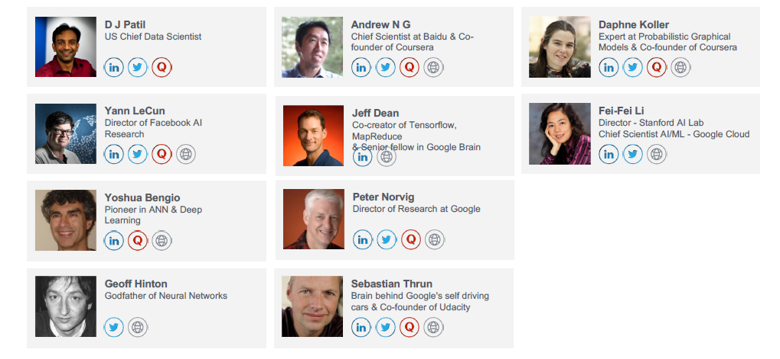
Real Data Science Expert

Slide 34
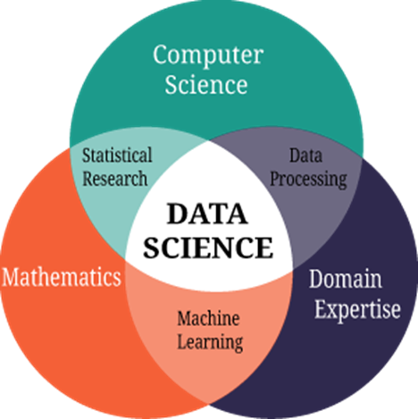
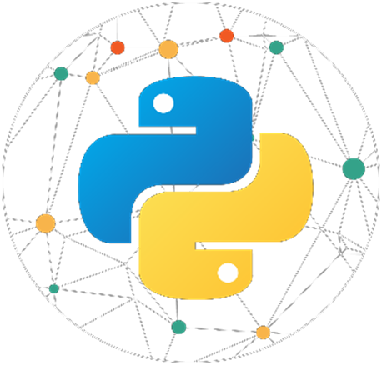
Deciding Data Science Career

Slide 35
Skills needed for Data Science
What would organizations like to look for when they evaluate you as a potential Data Scientist?
You need knowledge of all 3 domains to build effective analytics solutions
Statistical Knowledge – Design & Build the best algorithm
Business Understanding – Derive actionable business insights
Information Technology – Gather & Store data, Deploy Solution using Python, R, SAS

Slide 36
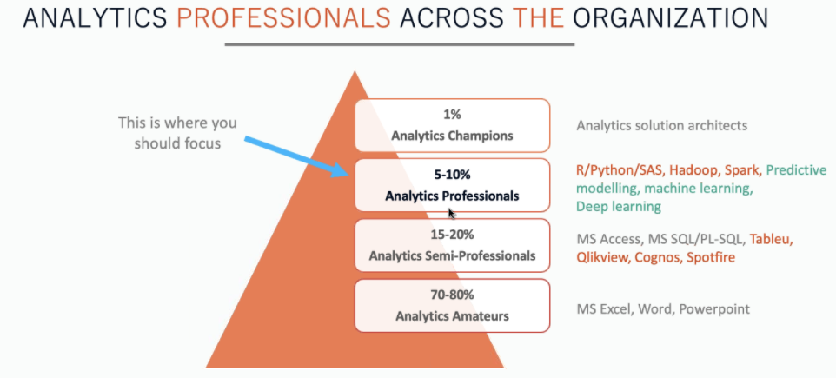
Career Opportunities

Slide 37
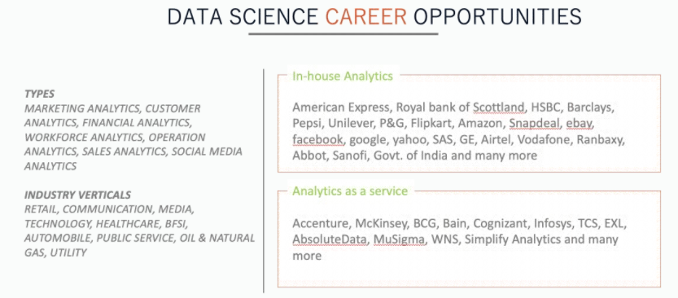
Career Opportunities..

Slide 38
Why Python is the ultimate choice for Data Science Career?

Slide 39
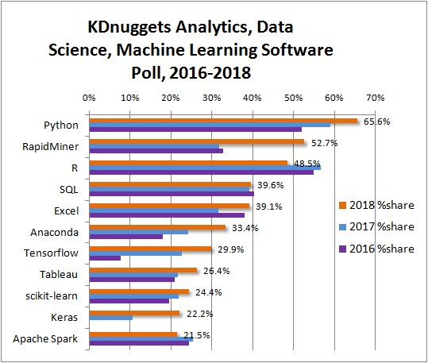
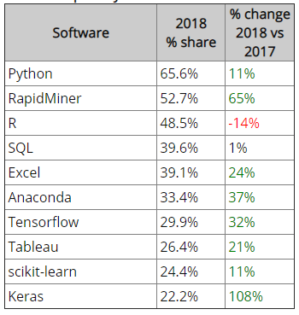
Why Python is the ultimate choice for Data Science?
Top Analytics/Data Science/ML Software in 2018 KDnuggets Poll

Slide 40
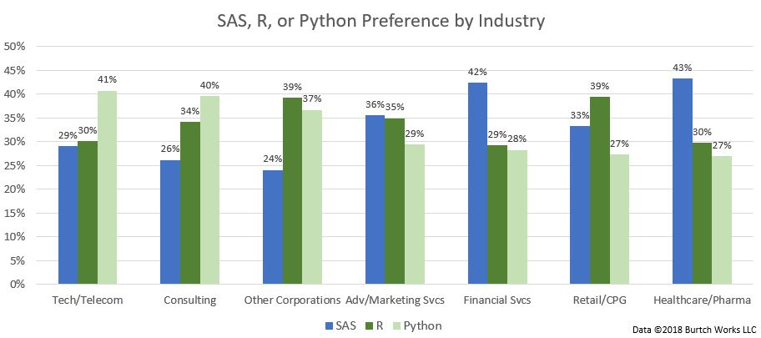
Why Python is the ultimate choice for Data Science?
Ref:https://www.kdnuggets.com/2018/05/poll-tools-analytics-data-science-machine-learning-results.html

Slide 41
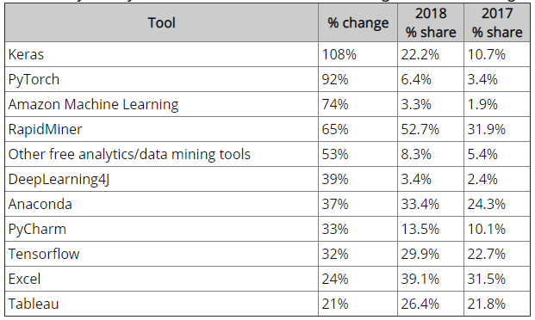
Top Machine Learning Tools for Data Science
Major Analytics/Data Science/ML Tools with the largest increase in usage

Slide 42
Top Deep Learning Tools for Data Science
Major Analytics/Data Science/DL Tools with the largest increase in usage
Top Deep Learning tools:
Tensorflow, 29.9%
Keras, 22.2%
PyTorch, 6.4%
Theano, 4.9%
Other Deep Learning Tools, 4.9%
DeepLearning4J, 3.4%
Microsoft Cognitive Toolkit (Prev. CNTK), 3.0%
Top Deep Learning tools:
Apache MXnet, 1.5%
Caffe, 1.5%
Caffe2, 1.2%
TFLearn, 1.1%
Torch, 1.0%
Lasagne, 0.3%

Slide 43
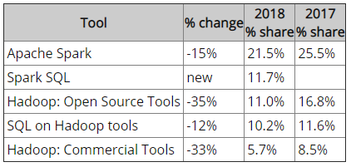
Big Data Tool: Hadoop drops
In 2018, about 33% used Big Data tools, either Hadoop or Spark - about the same as in 2017, but Hadoop usage has markedly declined - about 30%.
Here are the details

Slide 44

Programming Language: Top 1 Python
Python seems to swallow not only R, but also most other languages, except for SQL, Java, C/C++ which remained at about the same level. R has declined for the first time since we have run this survey. Other languages have also declined. Here are the main programming languages sorted by popularity.
Python, 65.6% (was 59.0% in 2017), 11% up
R, 48.5% (was 56.6%), 14% down
SQL, 39.6% (was 39.2%), 1% up
Java, 15.1% (was 15.5%), 3% down
Unix, shell/awk/gawk, 9.2% (was 10.8%), 15% down
Other programming and data languages, 6.9%, (was 7.6%), -9% down
C/C++, 6.8%, (was 7.1%), 3% down
Scala, 5.9%, (was 8.3%), 29% down
Perl, 1.0% (was 1.9%), 46% down
Julia, 0.7% (was 1.2%), 45% down
Lisp, 0.3% (was 0.4%), -25% down
Clojure, 0.2% (was 0.3%), -38% down
F, # 0.1% (was 0.5%), -73% down
Python Champion

Slide 45

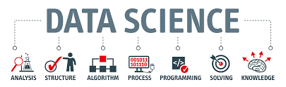
About Data Science

Slide 46
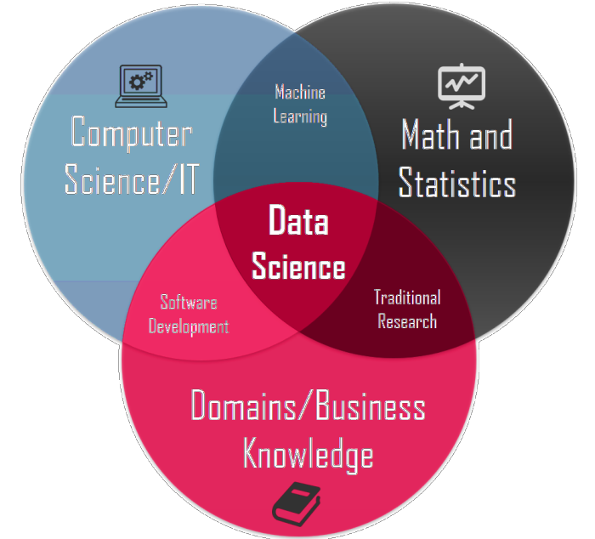
About Data Science
What is Data Science?
Data Science is a mixed discipline, which involves the use of statistics, computer science and Domain Knowledge.
Extracts information out of data by performing
analysis on the same
Dhanurjay "DJ" Patil is an American mathematician and computer scientist who served as the Chief Data Scientist of the United States under Barak Obama healthcare functions. Coined the word “Data Science”

Slide 47
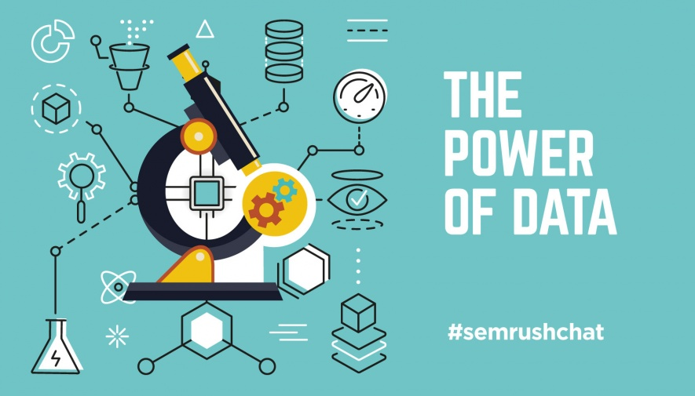
Data Science is the Power of Data

Slide 48
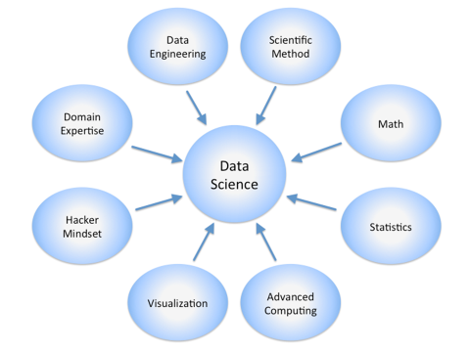
Data Science Deals with

Slide 49
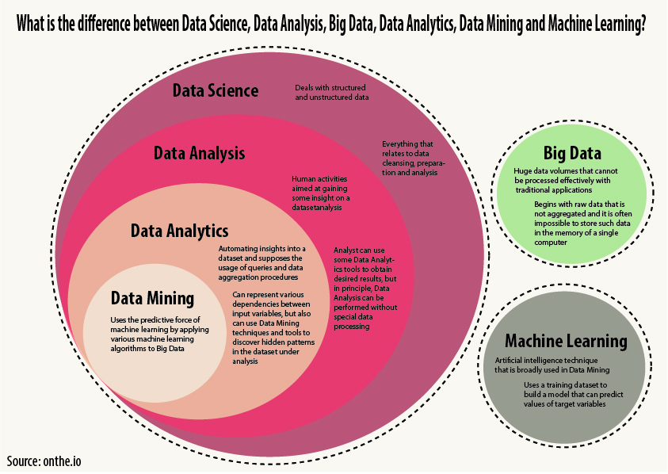

Slide 50
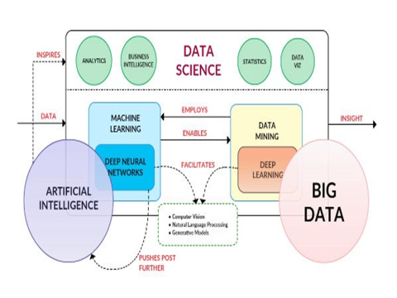
Data Science – Neighbourhood Technologies

Slide 51
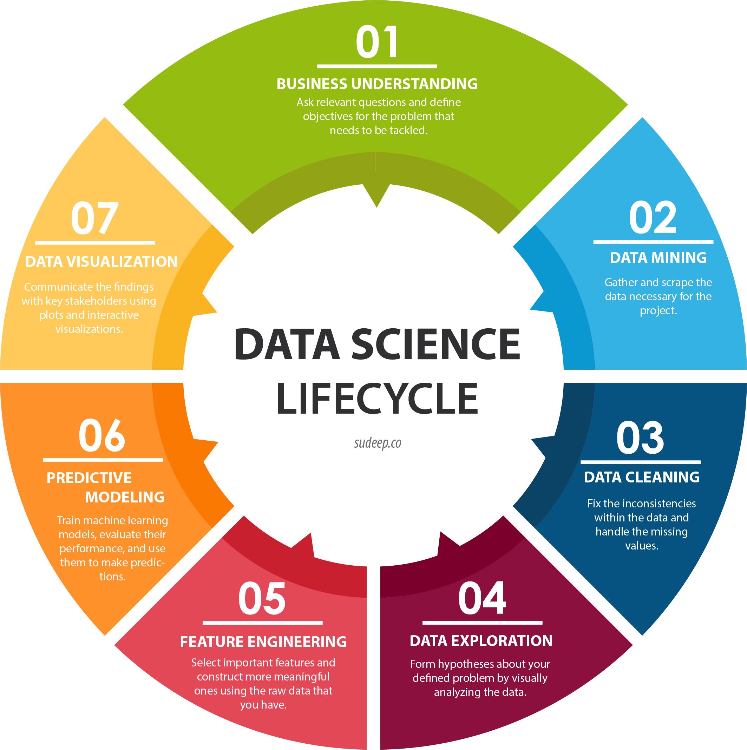
Data Science Life Cycle

Slide 52


Slide 53
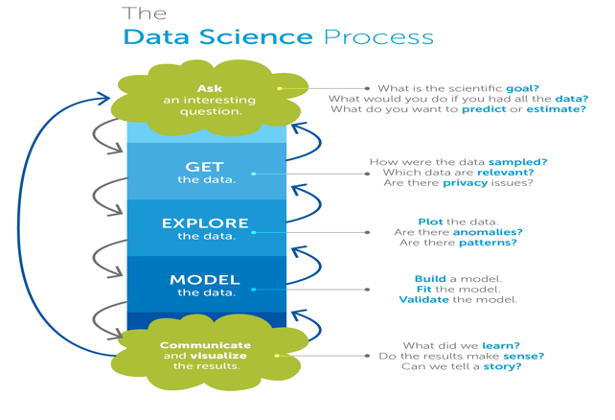
Data Science Process

Slide 54
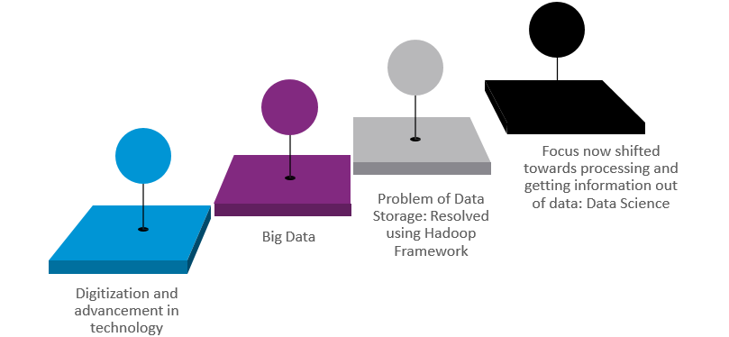
Why the world needs Data Science?

Slide 55





Future of Data Science
The digital age has changed the way we live, play, learn and work…

Slide 56


Data->Knowledge->Action
Companies must shift to a
Data-Driven
Business
According to Gartner, the self-learning (ML- powered) intelligent systems will continue to reign supreme in the technology marathon through 2020
are vulnerable to disruption
within
three years
72%

Slide 57
What do Data Scientist do?
We’ll discuss Data Scientist Responsibilities?

Slide 58
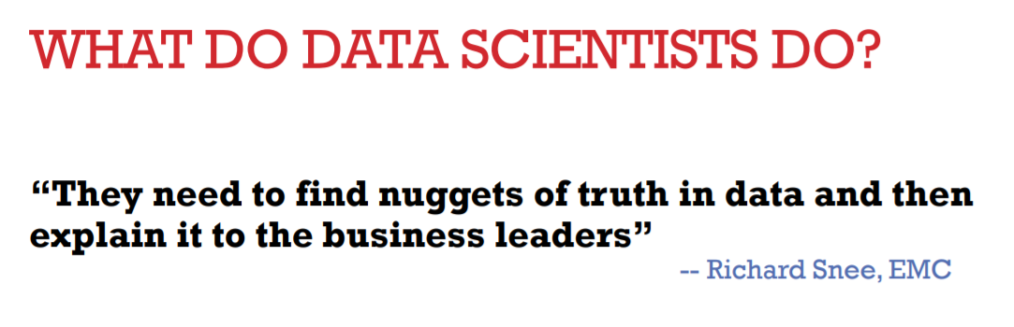
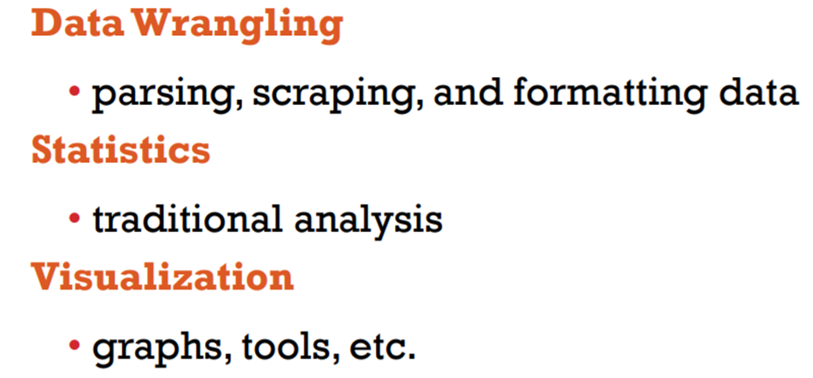
What do Data Scientist do?

Slide 59
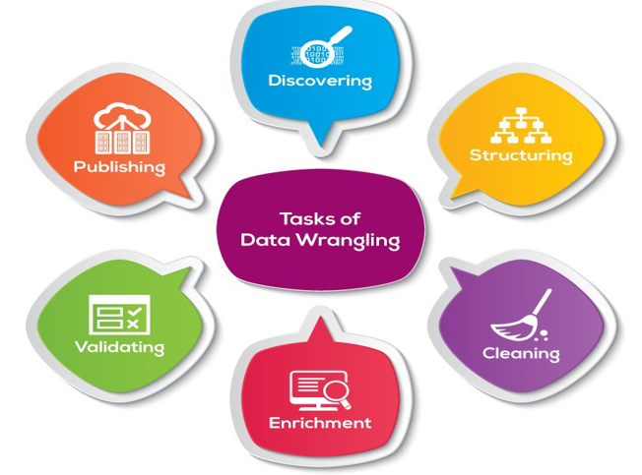
Data Wrangling

Slide 60
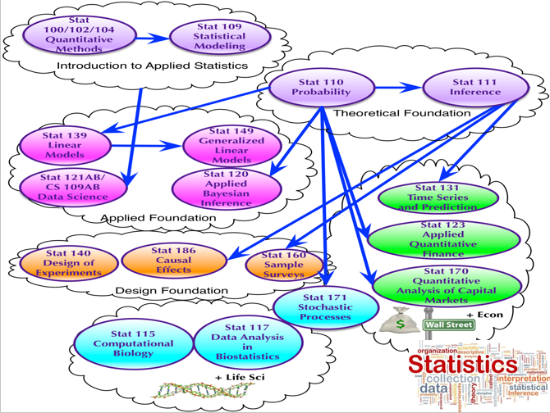
Statistics

Slide 61
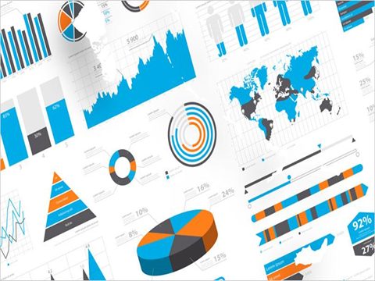
Analytics

Slide 62
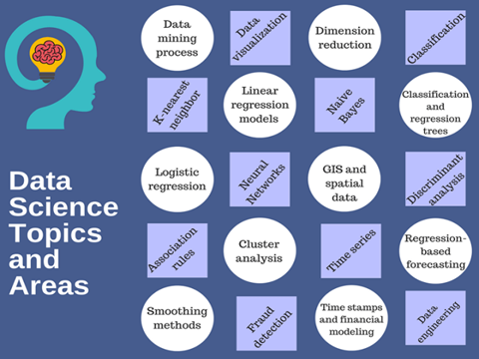
Data Science Topics & Core Areas

Slide 63
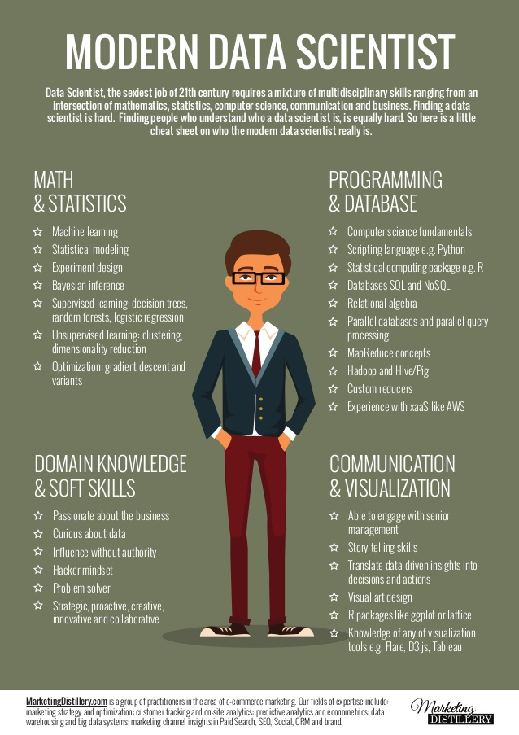
Modern Data Scientist

Slide 64
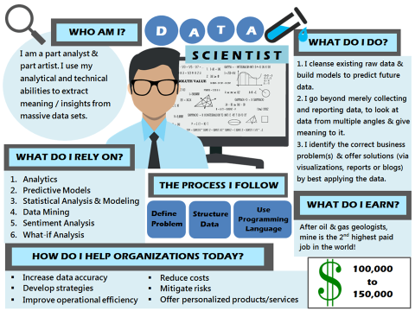
As a Data Scientist – What do I do?

Slide 65
Role of a Data Scientist
Responsible for designing and creating processes and layouts for complex, large-scale data sets used for modelling, data mining, and research purposes
Selecting features, building and optimizing classifiers using ML techniques
Data mining using state of the art methods
Extending company’s data with third party sources of information when needed
Processing, cleansing and verifying the integrity of data for analysis
Building predictive models using ML algorithms

Slide 66
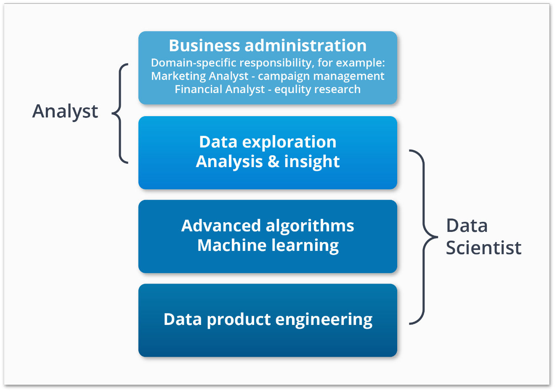
Skills Acquired by a Data Scientist

Slide 67
Machine Learning
Now let’s understand what Machine Learning is all about

Slide 68


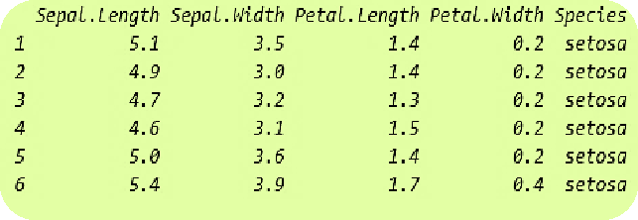

Machine Learning
Machine Learning is a type of artificial intelligence (AI) that provide computers with the ability to learn
without being explicitly programmed.
Problem Statement: Determine the species of the flower
Learn from the dataset

Slide 69

Machine Learning
Machine Learning is a type of artificial intelligence (AI) that provide computers with the ability to learn
without being explicitly programmed.
Problem Statement: Determine the species of the flower
New Input
Sepal length, Sepal width, Petal Length, Petal Width
Learn from the dataset

Slide 70
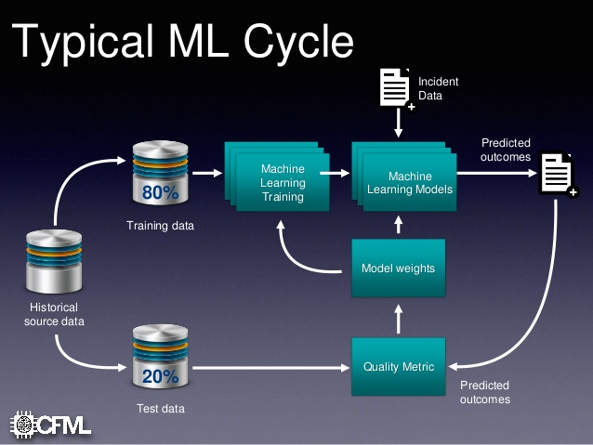
Typical Machine Learning Cycle

Slide 71
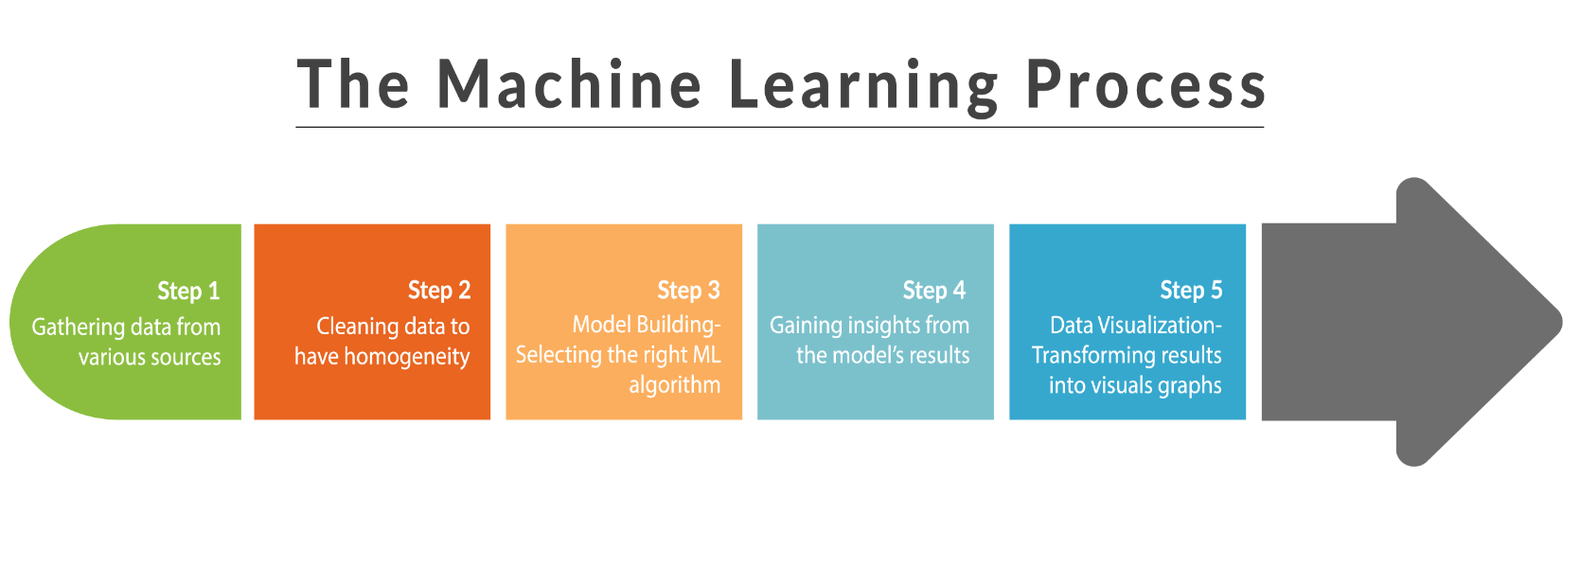
Machine Learning Process

Slide 72
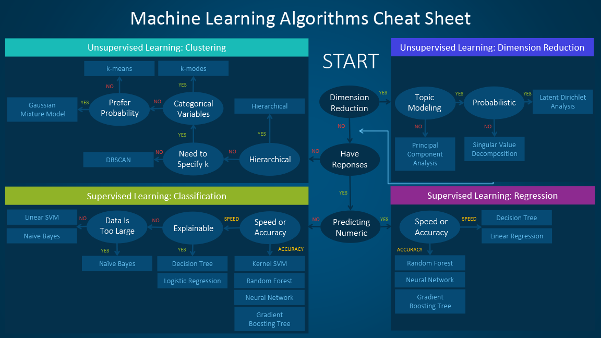
Machine Learning Algorithms Cheat Sheet

Slide 73
Machine Learning Types
Supervised | Unsupervised | Reinforcement

Slide 74


Slide 75
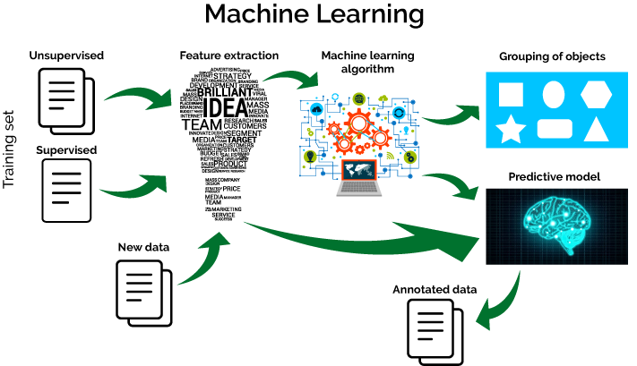
Machine Learning Algorithm

Slide 76

Machine Learning Models

Slide 77

Supervised Learning

Slide 78



Supervised Learning
Supervised Learning is where you have input variables (X) and an output variable (Y) and you use an algorithm to learn the mapping function from the input to the output.
1
Supervised
Learning
2
Unsupervised Learning
3
Reinforcement
Learning

Slide 79
Supervised Learning Algorithms
Linear Regression
Predicting numerical values such as house price
Regression
Supervised Learning
Logistic
Regression
Predicting binary variables
(yes or no)
Classification

Slide 80

Unsupervised Learning
Google Photos Segment
Customer Segmentation in Marketing

Slide 81

Unsupervised
Learning
Unsupervised Learning is the training of a model using information that is neither
classified nor labelled.
Supervised
Learning
This model can be used to cluster the input data in classes on the basis of their
statistical properties.
1
2
Unsupervised Learning
3
Reinforcement
Learning
Cluster - 1
Cluster - 2
Example: For a basket full of vegetables, we can cluster different vegetables based
upon their colour or size.

Slide 82

Reinforcement Learning

Slide 83

Reinforcement Learning Examples

Slide 84

Reinforcement Learning Examples

Slide 85


Reinforcement Learning
Reinforcement Learning (RL) is learning by interacting with a space or an environment.
Supervised
Learning
It selects its actions on basis of its past experiences (exploitation) and also by new choices (exploration).
Reward
or
11
2
Unsupervised Learning
Reinforcement
Learning
Good Job!
Penalty
3
Bad Job!
Stay on the same lane
Stay on the same lane
An RL agent learns from the consequences of its actions, rather than from being
taught explicitly.

Slide 86

Comparison – Machine Learning

Slide 87


Limitations of Machine Learning
Traditional Machine Learning algorithms have failed to solve crucial problems of AI, such as Natural language processing, image recognition and so on.
Can’t recognize
anything

Slide 88

Limitations of Machine Learning
Traditional ML algorithms were not useful while working with high dimensional data, that is where we have large number of inputs and outputs (eg: 100 or 1000 or even more).
People call this “The curse of dimensionality” as they observe certain Machine Learning algorithms may behave poorly when dimensions in the dataset is high.

Slide 89

Deep Learning Comes to the Rescue
Deep Learning is one of the only methods by which we can circumvent the challenges of feature extraction.
This is because Deep Learning models are capable of learning to focus on the right features by themselves,
requiring little guidance from the programmer.

Slide 90

Deep Learning Comes to the Rescue
When dealing with high dimension data, Deep Learning comes to the rescue by partially solving the dimensionality problem.
Deep Learning let users tweak the model complexity by redefining the network structure before feeding the sample for training.

Slide 91
Tools for Data Science

Slide 92







Tools for Data Science

Slide 93



Copyright © 2017, edureka and/or its affiliates. All rights reserved.

Slide 94


Slide 95

Copyright © 2017, edureka and/or its affiliates. All rights reserved.

Slide 96



